Slide 1
Software Engineering and Architecture
Roles, Responsibility, Behavior, Protocol

Slide 2
Programming Models
“The way we think about programs”…
  A program is a sequence of instructions operating on data
    Procedural thinking (How CPUs actually operate)
      Python, C, Pascal, Assembler
  A program is a sequence of pure functions, taking input and producing output
    Functional thinking (Mathematical computer science likes that a lot)
      F#, Scala, Haskel, ML
  A program is organized as interacting objects, encapsulating both data and operations
    Object-oriented thinking (Closer to how humans think)
      C#, Java, C++

Slide 3
Object-Orientation
Object-Orientation (OO) is about objects…
But what is an object?
It turns out – that there are several ways of thinking…
Language centric perspective:
Object = Data + Actions
Model centric perspective:
Object = Model element in domain
Responsibility centric perspective:
Object = Responsible for providing service
in community of interacting objects

Slide 4
Competing or Complementing?
These three models/ideas/perspectives
  Language centric perspective
  Model centric perspective
  Responsibility centric perspective
… are not “right or wrong” or competitors…
Rather they are all valid and sort of complement each other…
However, as ‘design and thinking tool’ for developing complex software architectures, you need to master all!

Slide 5
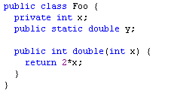
Language Perspective
Language perspective
  An object is a set of methods and variables grouped together
  Yes, this is true!
    The compiler treats it like that…
But it does not help me to
develop maintainable architectures and programs ☹
  No guidance on “what classes/what methods” to produce…
WarStory…
Notes:
WarStory: Maintaining system with an Aclass with all methods starting with ‘a’, Bclass = etc

Slide 6

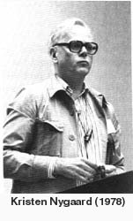
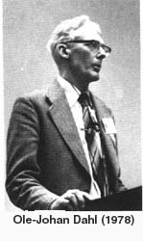
Model Perspective
Model centric focus
  focus on concepts and relations in the Domain
    generalization, association, composition
  problem domain modeling
  object = part of model
Strong Scandinavian Research Impact
Simula
1960-1990.
Alan Kay / Xerox PARC / Smalltalk 80
1980

Slide 7
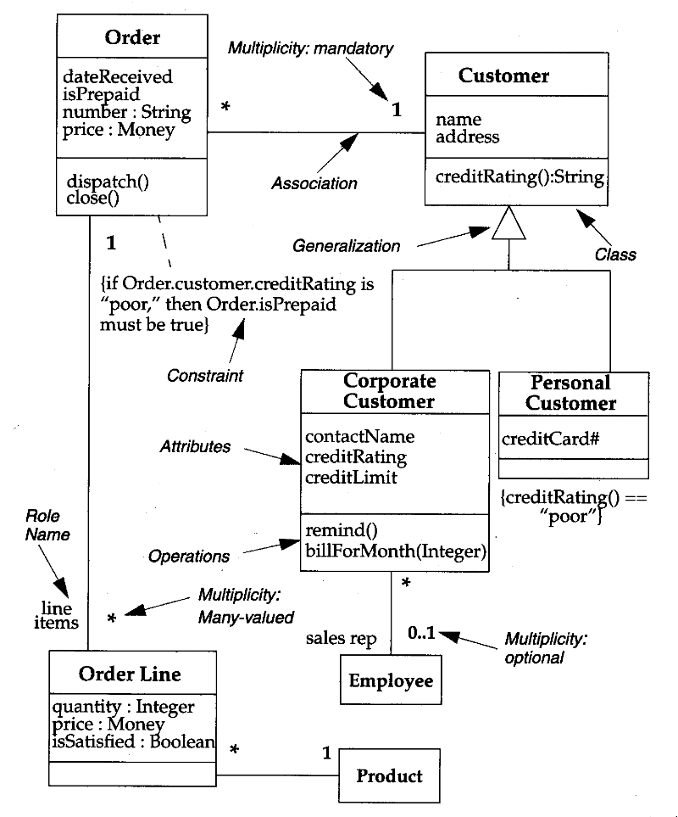
Model Perspective
Model centric focus
  A program execution is viewed as a
  physical model simulating the
  behavior of either a real or imaginary
  part of the world.
  [Madsen, Møller-Pedersen, Nygaaard 1993]
Talk to customer and identify
“things” they talk in terms of.
Then “model” these in the
program: Domain Modelling.

Slide 8
Model Perspective
This perspective helps me greatly in my architecture and design of my program…
  “We want a card game played by two heroes”
  Better make a Card class and a Hero class
Design process is a Who / What cycle
  Who: the objects comes first
  What: the behavior comes second
Define the classes, next define their methods…
IntProg and the BlueJ system is rooted in this paradigm…

Slide 9
Critique
I developed using this paradigm for 10 years…
And it caused me great trouble. I always ended up in
The Blob / God class
The issue is that ‘domain’ (= core business concepts) only covers a fraction of all the objects we need for a large IT system!
  Design patterns do not appear in the domain. UI does not appear in the domain. Databases, networks, fault tolerance, security, performance optimizations, testing, etc. does not appear in the domain…

Slide 10
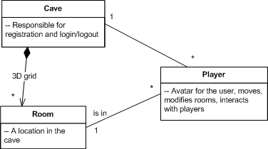
Example: SkyCave
From my Microservice and DevOps course
  Domain model:
    Three Concepts
  Implementation model:
    94 classes
    Patterns, dep. injection,
    network, databases,
    caching, availability,
    performance, …

Slide 11
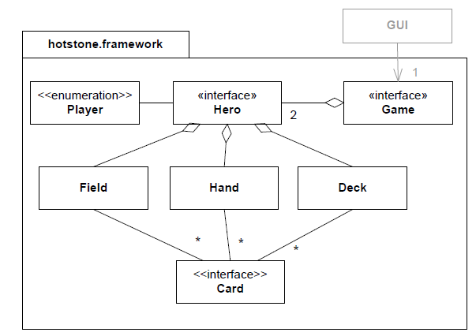
Example: HotStone
If strictly Model based
  A) Identify landscape of concepts
  B) Distribute behavior over this landscape
… then I would only have
  3 to 5 classes
My solution code have over
100 interfaces/classes!
  Strategies, dep inject,
  distribution, GUI, caching,
  testing, name services,
  logging, database recordings,
  …

Slide 12
Critique
Design process is a Who / What cycle
  Who: the objects comes first
  What: the behavior comes second
… will make me end up with few classes with zillions of methods covering all kinds of aspects ☹
  That is: The Blob

Slide 13
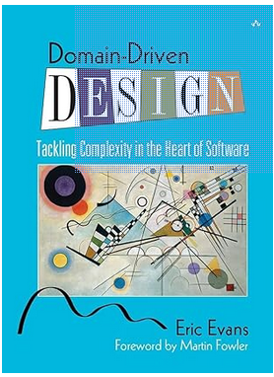
Not a Wrong Thinking per se…
There is a lot of merits to Domain Modelling
  Idea of Bounded Contexts is a prevailing way
  of organizing microservices
The point is, if you only create objects/
classes from these domain concept, they
will be overcrowded by too many
responsibilities… Blobbing…

Slide 14
Responsibility-centric

Slide 15
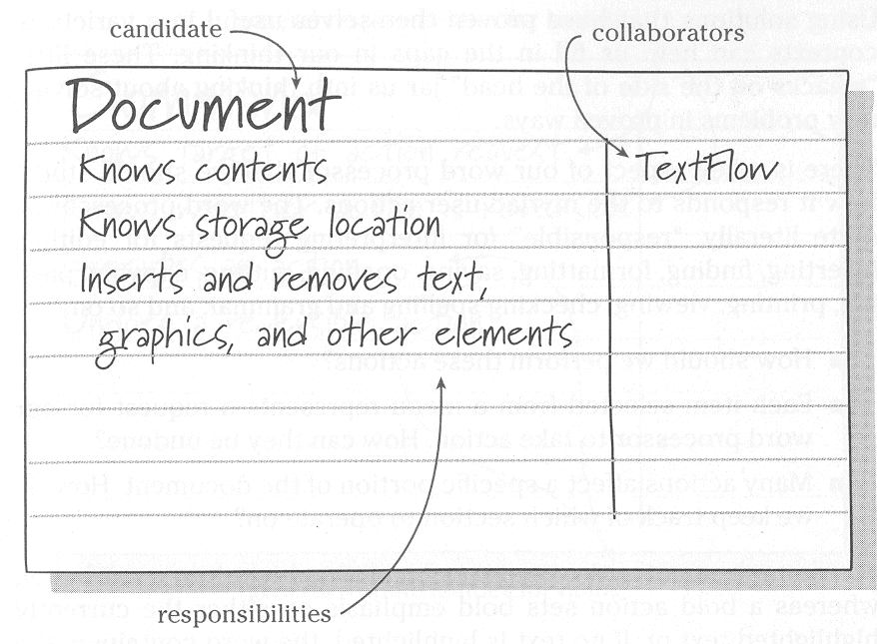
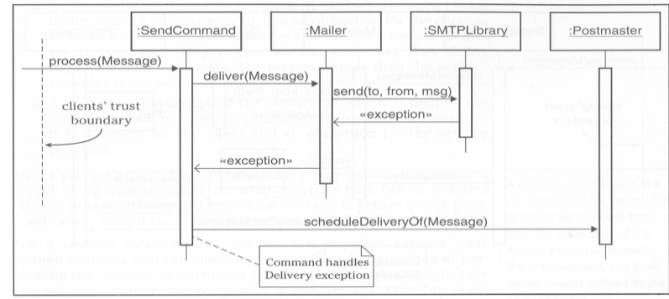
Focus
Responsibility centric focus
  Role, responsibility, and collaboration
  Object = provider of service in community
  Leads to strong behavioral focus
  CRC cards (Kent Beck, Rebecca Wirfs-Brock)

Slide 16
Another Definition
Another definition:
An object-oriented program is structured as a community of interacting agents called objects. Each object has a role to play. Each object provides a service or performs an action that is used by other members of the community.
  Budd 2002
Shifting focus
  away from “model of real world”
  towards “community”, “interaction”, and “service”

Slide 17
Service
Budd’s definition is more skewed towards the functionality of the system.
At the end of the day, software pays the bill by providing functionality that the users need, not by being a nice model of the world!
Services are what developers get paid to create!

Slide 18
What/Who
Timothy Budd:
“Why begin the design process with an analysis of behavior? The simple answer is that the behavior of a system is usually understood long before any other aspects.”
What / Who cycle
  What: identify behavior / responsibility ⇨ roles
  Who: identify objects that may play the roles
    or even invent objects to serve roles only
      Larman “Pure fabrication”;

Slide 19
Implications
Responsibility perspective:
  A) Analyze behavior (what?)
  B) Assign objects (who?)
Guidelines:
  A) Behavior abstracted ⇨ landscape of responsibilities
  B) Implement responsibilities in objects
Analysis
  Resemble human organizations – often roles are invented
  Still need to define the objects ☺
    That is, the person(s) to fill the role

Slide 20
The Central Concepts
A strong mind-set for
designing flexible software
“Theory of Compositional Designs”

Slide 21
How people organize work!
The central concepts:
  Behavior: What actually is being done
    ”Henrik sits Sunday morning and writes these slides”
  Responsibility: Being accountable for answering request
    ”Henrik is responsible for teaching responsibility-centric design”
  Role: A function/part performed in particular process
    ”Henrik is the course teacher of SWEA”
  Protocol: Convention detailing the expected sequence of interactions by a set of roles
    ”Teacher: ‘Welcome’ => Students: stops talking and starts listening”
    Student asks question; teacher is expected to answer

Slide 22
It is all Roles and Protocol
Any complex human organization relies completely on each person understanding roles and protocols
  If I get hospitalized, I understand the roles of patient, nurses, and physicians
  CEOs, managers, software developers, architects, testers, sales people, …
  Hardship of marriage: finding the proper roles and protocols ☺
    Role models?

Slide 23
Roles decouples
The primary point of roles:
It provides a higher abstraction than that of the individual person
I know my responsibilities and the protocol once I am assigned a known role
  Teacher role defines what my responsibilities are
I can collaborate efficiently with others once I know their roles
  Student role defines what I can expect them to do

Slide 24
Many-to-many relation
Big company
  One person is manager, one software architect, two lead developers, and ten software developers
Small company
  Same person is manager, software architect, lead and software programmer ☺
That is: One individual may serve many roles
Henrik: Teacher, researcher, tax payer, company owner, tourist, father, husband, …
Interface Segregation Principle

Slide 25
Many-to-many relation
Hospital
  Nurses attend the patients
  And different persons serve the role during shifts
That is: One role may be served by many persons
Substitution Principle

Slide 26
Role concept
The role concept allows us to use either approach (who/what or what/who) because “what” can be expressed as roles.
Role makes service a first-class citizen of our design vocabulary
Relation
Role
Object

Slide 27
Roles may be invented
Roles may be invented by need.
A pre-school kindergarten invented a Flyer role whose responsibility it was to ‘catch’ all interruptions to make the daily work more fluent for the ‘non-flyer’ pedagogues.

Slide 28
Enough Academic B…….
What should I do when designing???

Slide 29
Software as Organizations
The proposal:
  Think software design in terms of
    The responsibilities to be served
    Group then into cohesive roles
    And define their protocols, how are they going to collaborate
That is:
Design software as an Organization

Slide 30
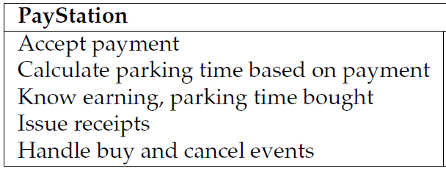
Super simple example
The Pay station
Now, one responsibility has been put into another role: the RateStrategy.
  And different objects may play that role…

Slide 31
Another Example
HotStone
  Game (= manager/coordinator)
    Role: Is responsible for overall game mechanics
      Card handling, hand, battlefield, attacks, turn taking, rules enforcer…
    Collaborates with lots of other roles
  Hero, Card (= specialists)
    Role: Primary state holders + simple, local, state changes
      Owner, health, mana, …
  WinnerStrategy (= super-specialist ☺)
    Role: Is responsible for calculating who has won
      Access information from other roles to do the calculation
  DeckBuildingStrategy
    Role: Is responsible for creating a deck
  ect.

Slide 32
Yet Another Example
SkyCave
  Massive multiplayer on-line exploration experience
(Some of the many) Roles:
  Cave, Player, Room
    Domain abstractions
      Player with name may move in rooms in cave, and create new rooms to share with other players
  Broker
    Responsible for remote method calls (actually 6 roles!)
  CaveStorage
    Responsible for persisting rooms and players
  SubscriptionService
    Responsible for authenticating player login
MicroService paradigm!

Slide 33
Programming Mechanics
Use interface to define a role
  Methods embody the responsibilities
  (the protocol must be understood in the design)
    Still lack programming constructs to describe these ☹
Classes implementing an interface allow objects to be instantiated to serve the roles
(Simple roles with no need for variability – just use a class)
  Typical example is ”records” = dump data containers
    Java 17 directly has a ‘record’ type (at last…)

Slide 34
A many-to-many relation
Interface – Object is a many-to-many relation
  One role/interface implemented by many objects
    Interface Game has been implemented in 70+ ways in your work
  One object may implement many interfaces
    StandardGame is both a ‘Game’ (UI uses this) and an ‘InternalMutableGame’ (Strategies uses this)
Object
Role/Interface
*
*

Slide 35
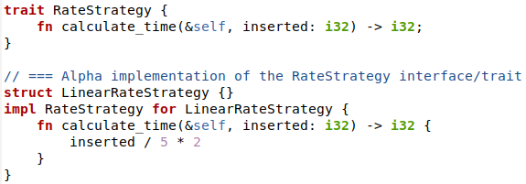
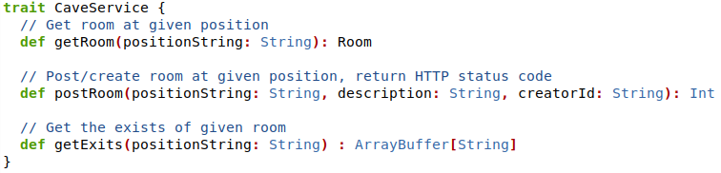
Language Support
I find support for interface to define a role extremely important in a language!
Rust supports Traits
Scala also has Traits

Slide 36
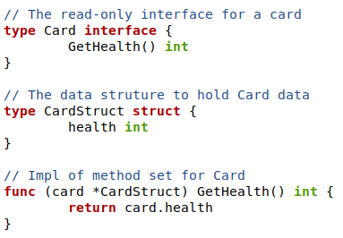
Language Support
Go has interface, but no way of expressing that a certain ‘object’ needs to implement it
  Duck typing
  No way of expressing that
  CardStruct ‘implements Card’
Morale:
Designing in Roles is a strong paradigm.
Some languages support it better…

Slide 37
An Example
Of identifying roles instead of
domain concepts

Slide 38
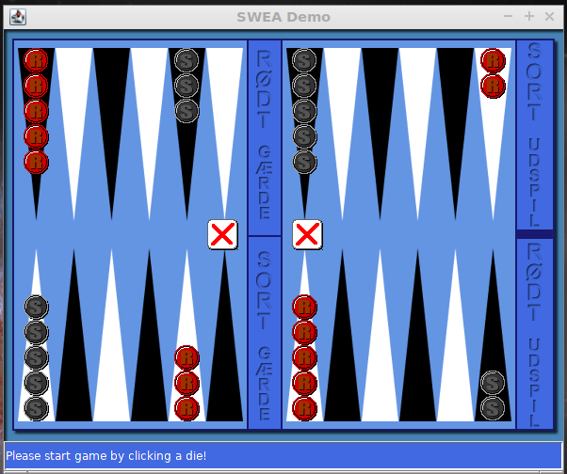
HotGammon
Backgammon requirements:
  Offer GUI for two players
  Guaranty proper play
Variants
  new rules for which moves are legal
  how many moves you can make per turn?
  how the board is initially set up?

Slide 39
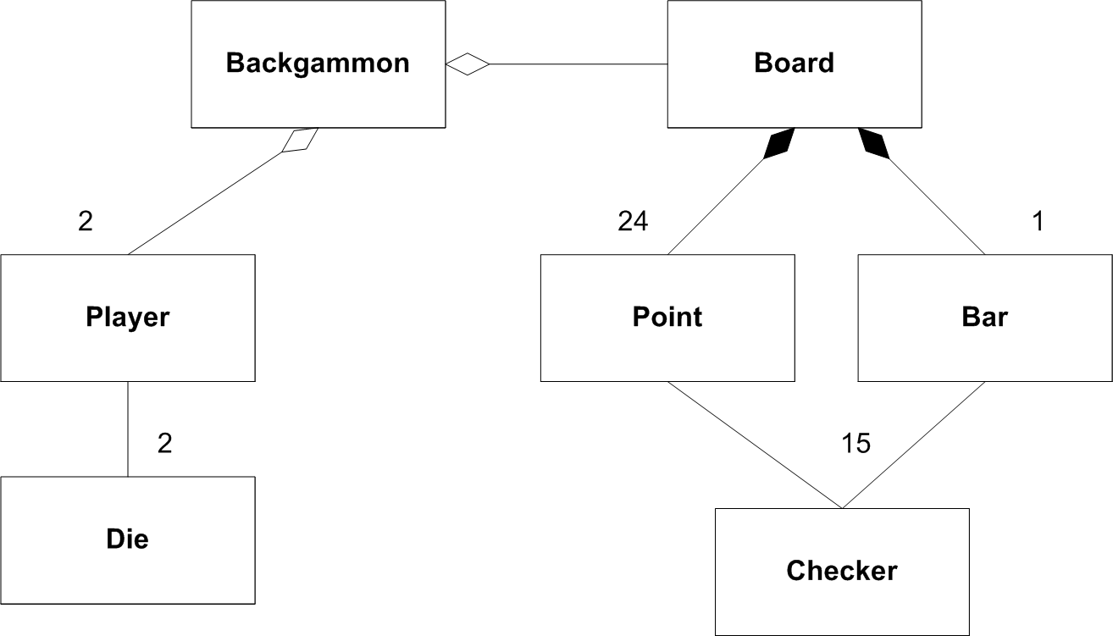
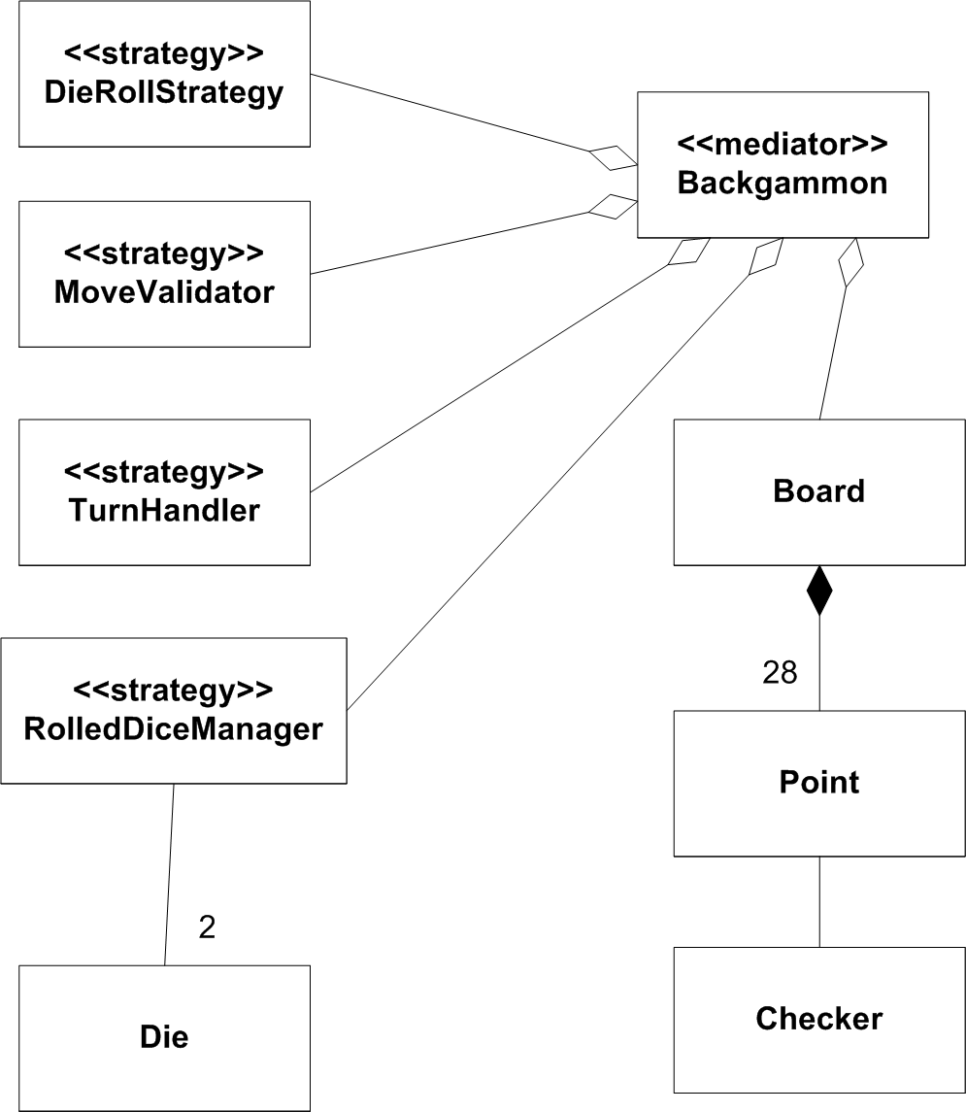
Same challenge – different designs
Model perspective:
Responsibility perspective:
Objects from domain
Objects providing services

Slide 40
Who is responsible for validating moves?
Model perspective:
Responsibility perspective:
What is the cost of altering algorithm to compute if move is valid?
How to change it at run-time?

Slide 41
Summary

Slide 42
Summary
The central concepts:
  Behavior: What actually is being done
    ”Henrik sits Sunday morning and writes these slides”
  Responsibility: Being accountable for answering request
    ”Henrik is responsible for teaching responsibility-centric design”
  Role: A function/part performed in particular process
    ”Henrik is the course teacher”
  Protocol: Convention detailing the expected sequence of interactions by a set of roles
    ”Teacher: ‘Welcome’ => Students: stops talking and starts listening”

Slide 43
Perspectives
Three different perspectives on OO
  Language: Important because code is basically only understandable in this perspective
  Model: Important because it gives us good inspiration for organizing the domain code
  Responsibility: Important because it allows us to build highly flexible software with low coupling and high cohesion
They do not have to be in conflict – they build upon each other...

Slide 44
Role Perspective
Thinking in responsibilities grouped into roles is a strong design model
  And it is not only relevant for Object-Oriented design thinking
It works well in the imperative design world as well
  As evident that Rust/Go and others have ‘interface’ constructs
Regarding functional programming? Yes, why not
  But I am no expert so…

Slide 45
Summary
Design in terms of what roles and responsibilities there are in a system.
Express these as interfaces with appropriate additional documentation.
  Or ‘traits’ in some languages
Implement the roles by concrete classes.
Roles should encapsulate points of variability

